Slide 1

Chapter 7: Syntax-Directed Translation
陳奇業 成功大學資訊工程系

Slide 2
Semantic Analyzer
Semantic Structure
What is the program supposed to do?
Semantics analysis can be done during syntax analysis phase or intermediate code generator phase or the final code generator.
typical static semantic features include declarations and type checking.
information (attributes) gathered can be either added to the tree as annotations or entered into the symbol table.

Slide 3
Two Categories of Semantic Analysis
Semantic analysis can be divided into two categories.
The first is the analysis of a program required by the rules of the programming language to establish its correctness and to guarantee proper execution.
The second category of semantic analysis is the analysis performed by a compiler to enhance the efficiency of execution of the translated program. This kind of analysis is usually included in discussions of optimization, or code improving techniques.

Slide 4
Compiling Process & Compiler Structure
Input (Stream of chars)
char handler
scanner
parser
semantic analyzer
intermediate code generator
code optimizer
code generator
peephole optimizer
Target Code

Slide 5
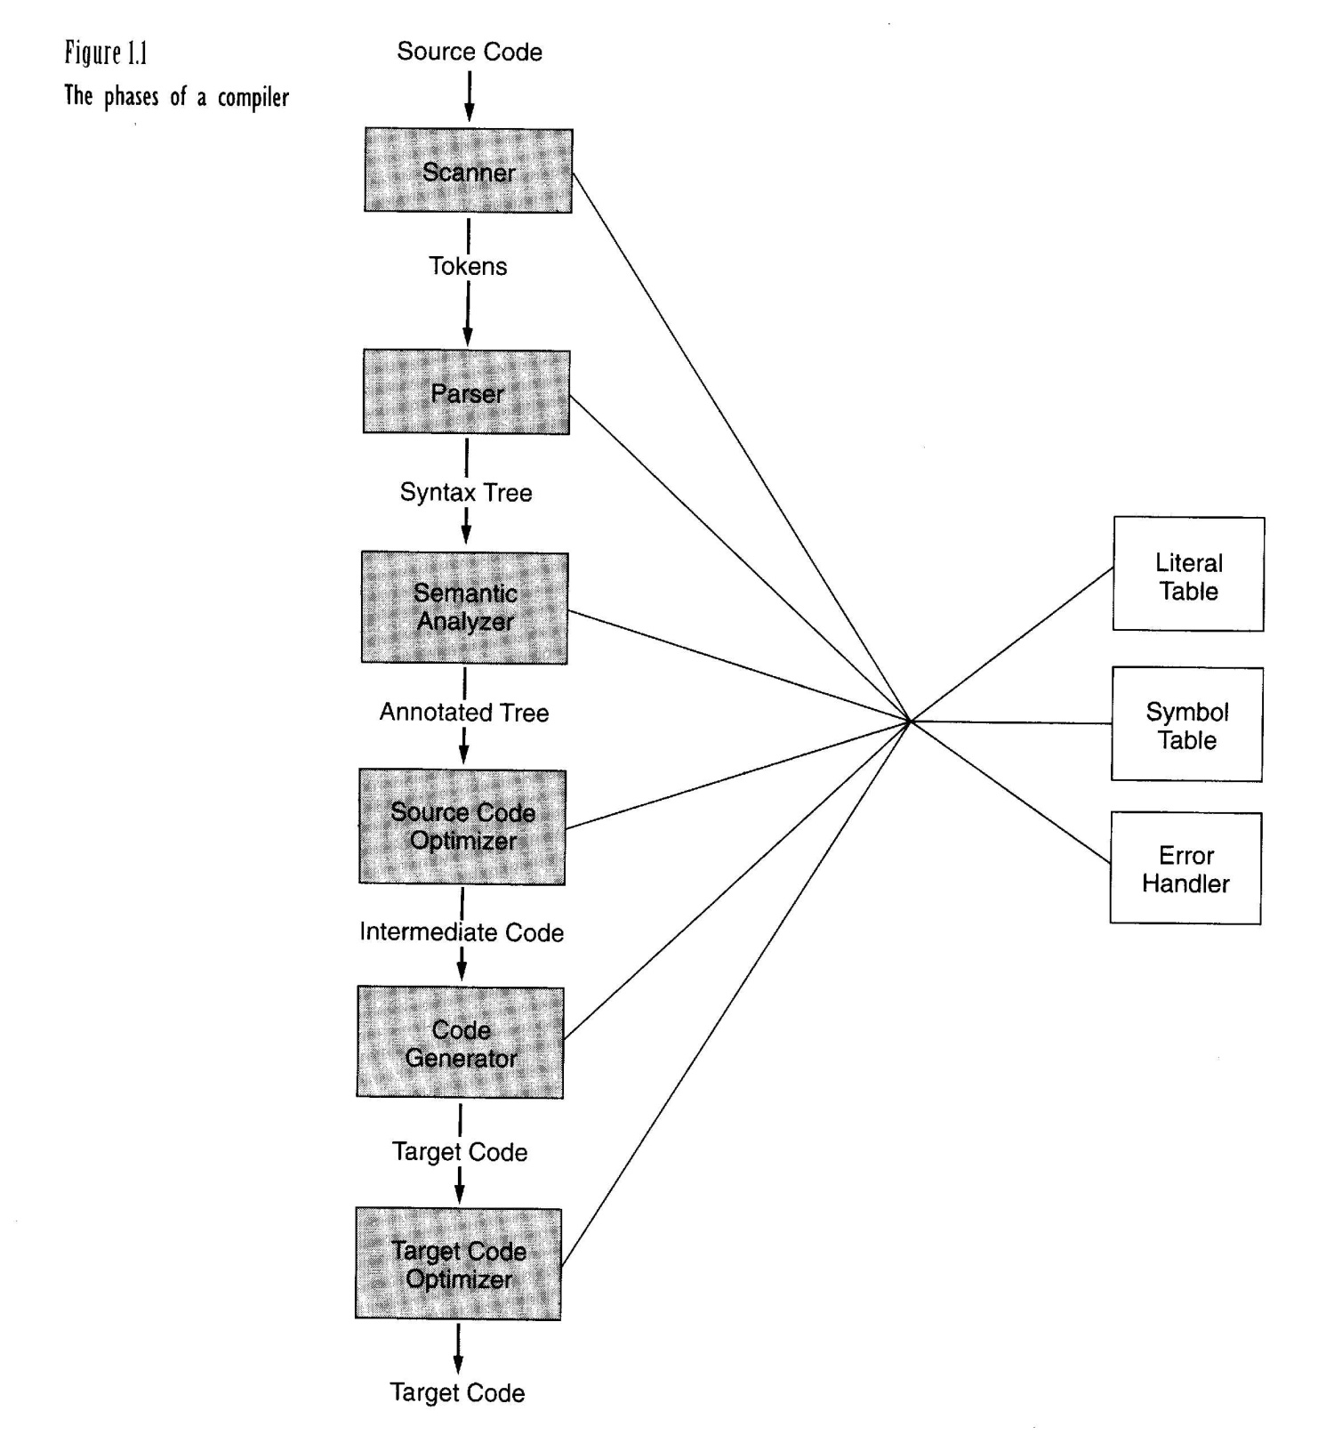

Slide 7
Semantic Analysis Process
includes formally:
description of the analyses to perform
implementation of the analysis (translation of the description) that may use appropriate algorithms.

Slide 8
Description of Semantic Analysis
Identify attributes (properties) of language (syntactic) entities.
Write attribute equations (or semantic rules) that express how the computation of such attributes is related to the grammar rules of the language.
Such a set of attributes and equations is called an attribute grammar.

Slide 9
Syntax-directed semantics
The semantic content of a program is closely related to its syntax.
All modern languages have this property.

Slide 10
Attributes
An attribute is any property of a programming language construct.
Typical examples of attributes include the data type of a variable, the value of an expression, the location of a variable in memory, the object code of a procedure, the number of significant digits in a number.
Attribute corresponds to the name of a field of a structure.

Slide 11
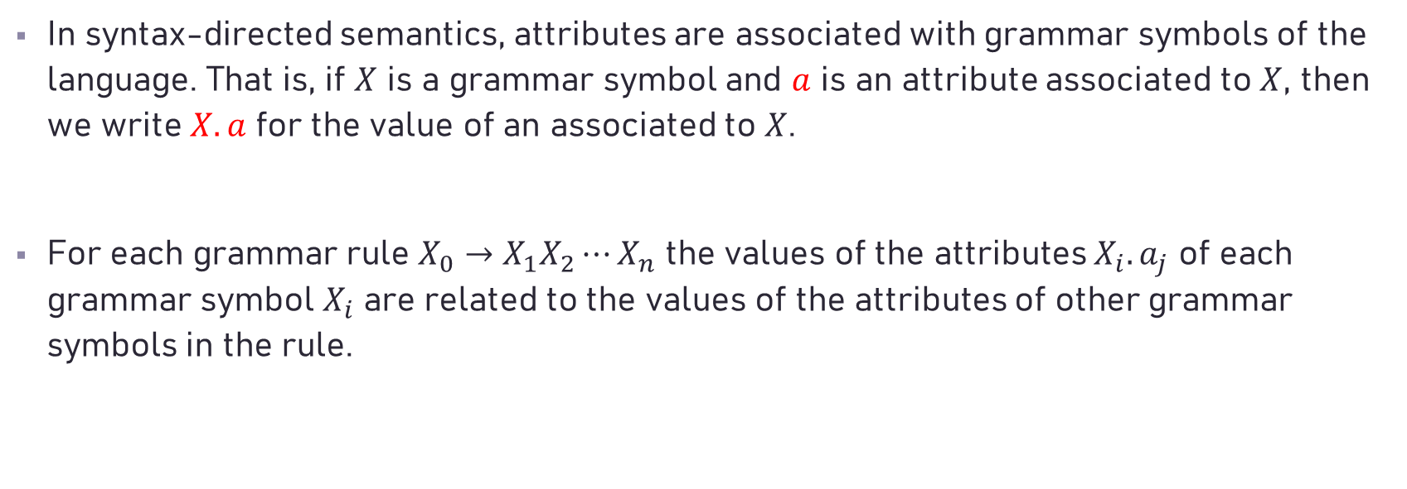
Attribute Grammars
In syntax-directed semantics, attributes are associated with grammar symbols of the language. That is, if $X$ is a grammar symbol and $a$ is an attribute associated to $X$, then we write $X.a$ for the value of an associated to $X$.
For each grammar rule $X_{0}→X_{1}X_{2}⋯X_{n}$ the values of the attributes $X_{i}.a_{j}$ of each grammar symbol $X_{i}$ are related to the values of the attributes of other grammar symbols in the rule.

Slide 12
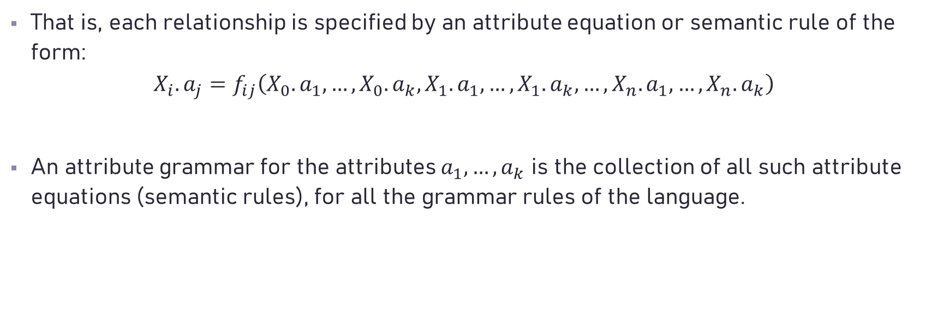
Attribute Grammars
That is, each relationship is specified by an attribute equation or semantic rule of the form:
$$X_{i}.a_{j}=f_{ij}\left(X_{0}.a_{1},…,X_{0}.a_{k},X_{1}.a_{1},…,X_{1}.a_{k},…,X_{n}.a_{1},…,X_{n}.a_{k}\right)$$
An attribute grammar for the attributes $a_{1},…,a_{k}$ is the collection of all such attribute equations (semantic rules), for all the grammar rules of the language.

Slide 13
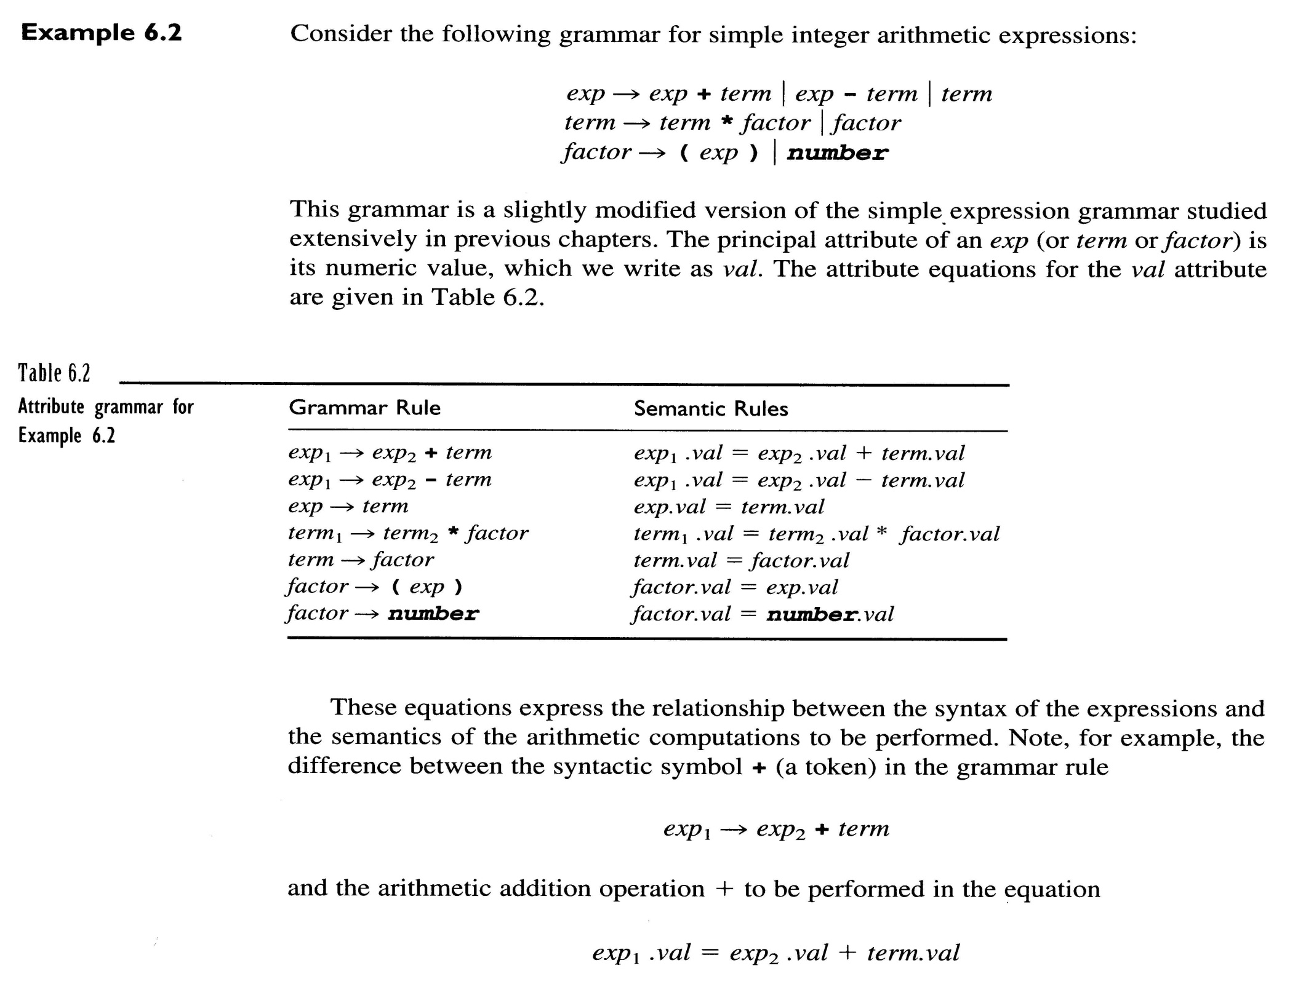
number.val must be
computed prior to
factor.val

Slide 14
Attribute grammars may involve several
interdependent attributes.

Slide 15
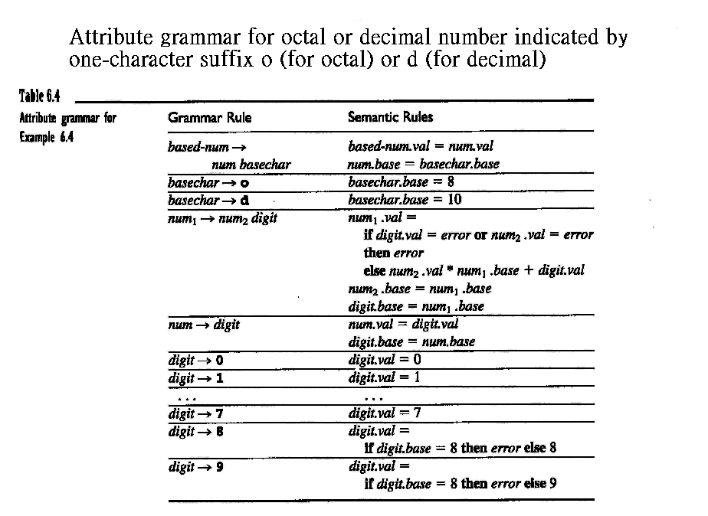
e.g. 345o
128d
128o (x)

Slide 16
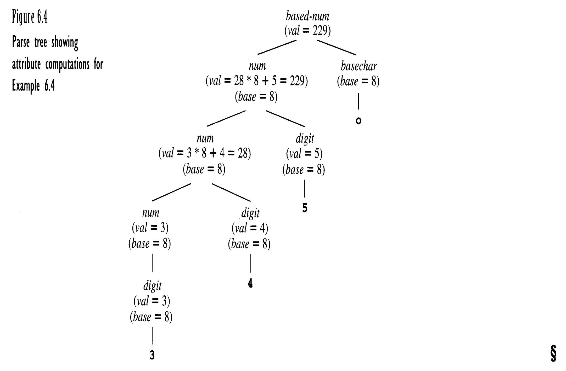

Slide 17
Attribute grammars may be defined for
different purposes.

Slide 18
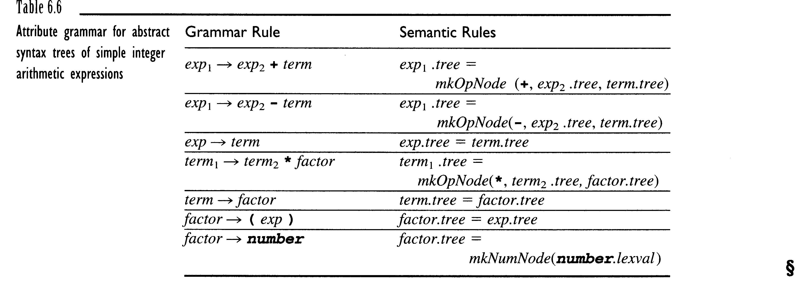

Slide 19
Algorithms for attribute computation
Dependency graph and evaluation order

Slide 20
Attribute grammar for simple C-like variable declarations
Grammar Rules Semantic Rules
decl → type var-list var-list.dtype = type.dtype
type → int type.dtype = integer
type → float type.dtype = real
var-list₁ → id , var-list₂ id.dtype = var-list₁.dtype
var-list₂.dtype = var-list₁.dtype
var-list → id id.dtype = var-list.dtype

Slide 21
decl
type
var-list
(dtype = real)
(dtype = real)
id
,
var-list
float
(x)
(dtype = real)
(dtype = real)
id
(y)
Parse tree for the string
float x , y
(dtype = real)

Slide 22
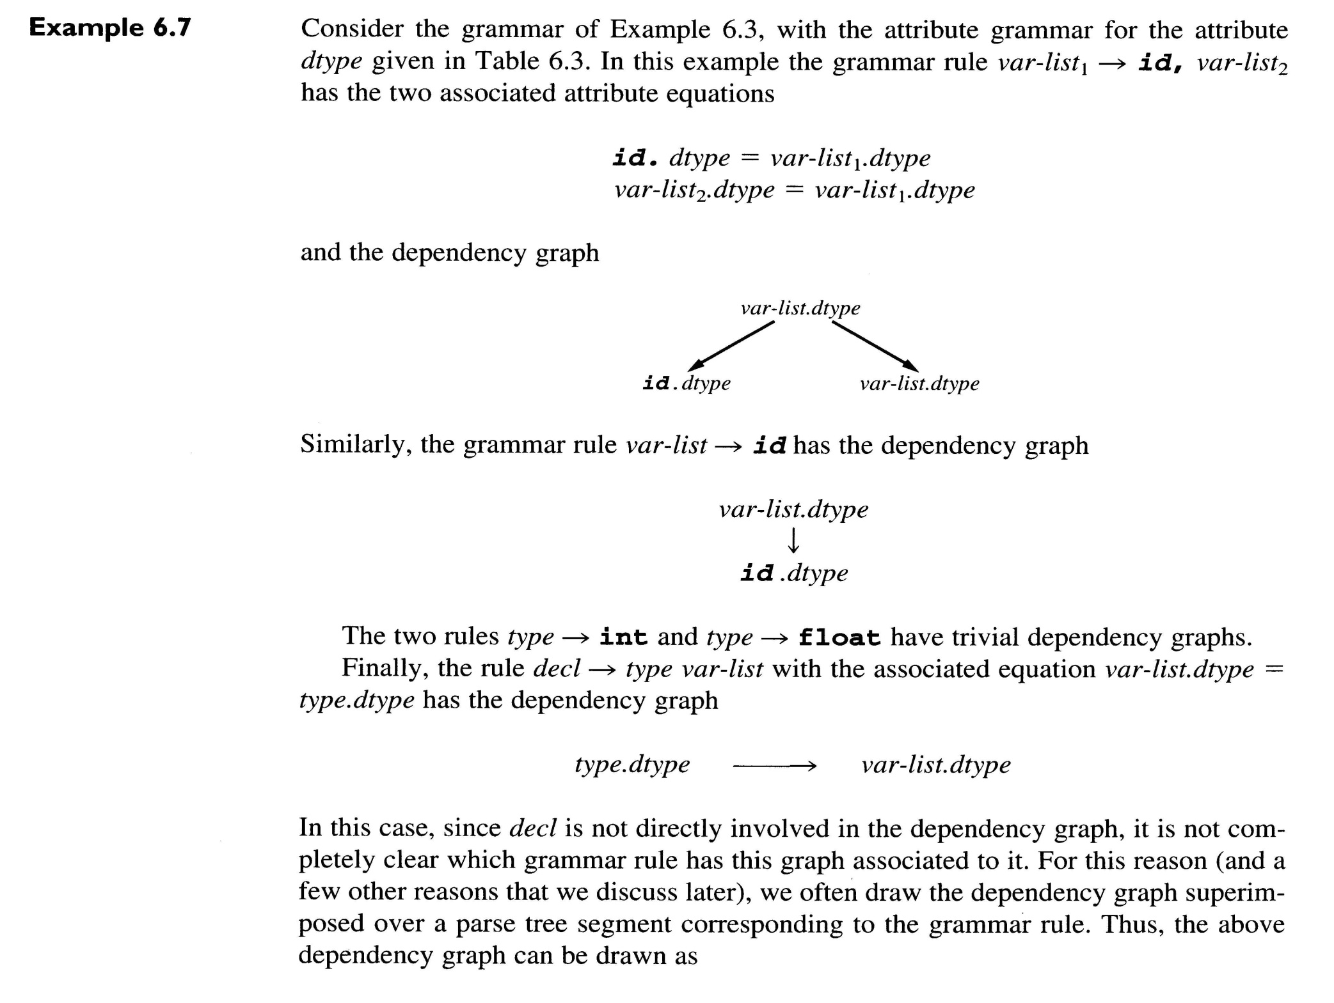

Slide 23
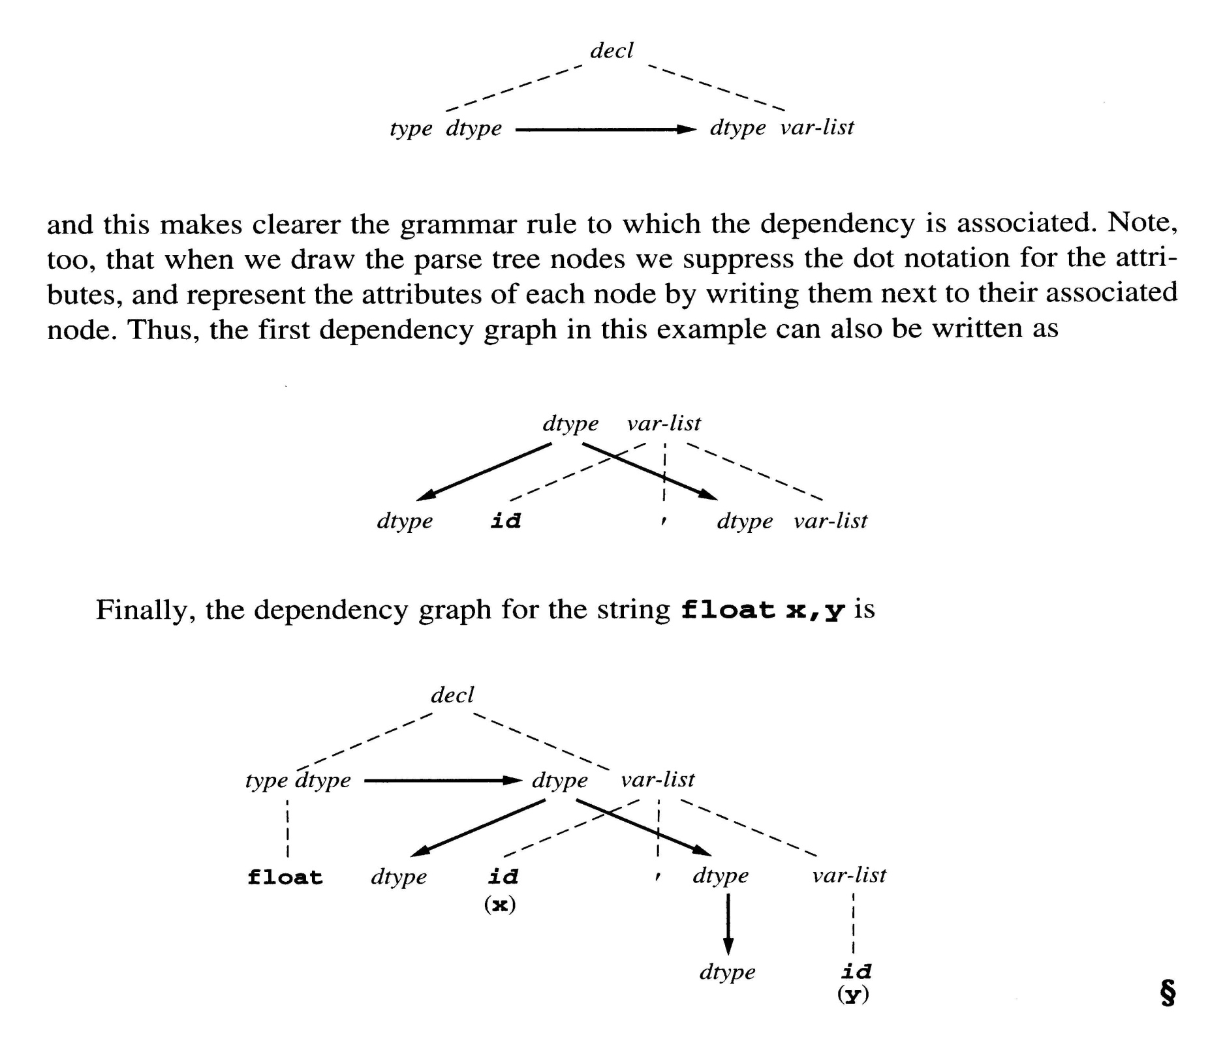

Slide 24
decl
type
var-list
(dtype = real)
(dtype = real)
trivial
dependency
id
,
var-list
float
(x)
(dtype = real)
(dtype = real)
id
(y)
Parse tree for the string
float x , y
(dtype = real)

Slide 25
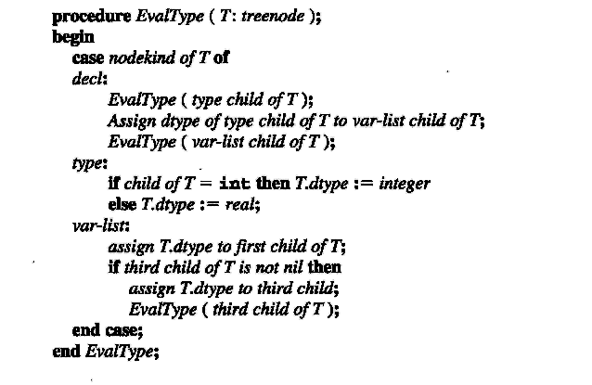

Slide 26
Procedure PreEval (T: treenode);
begin
for each child C of T do
compute all inherited attributes of C;
PreEval (C);
end;
Algorithm for evaluating inherited attributes ➔ preorder traversal

Slide 27


Slide 29
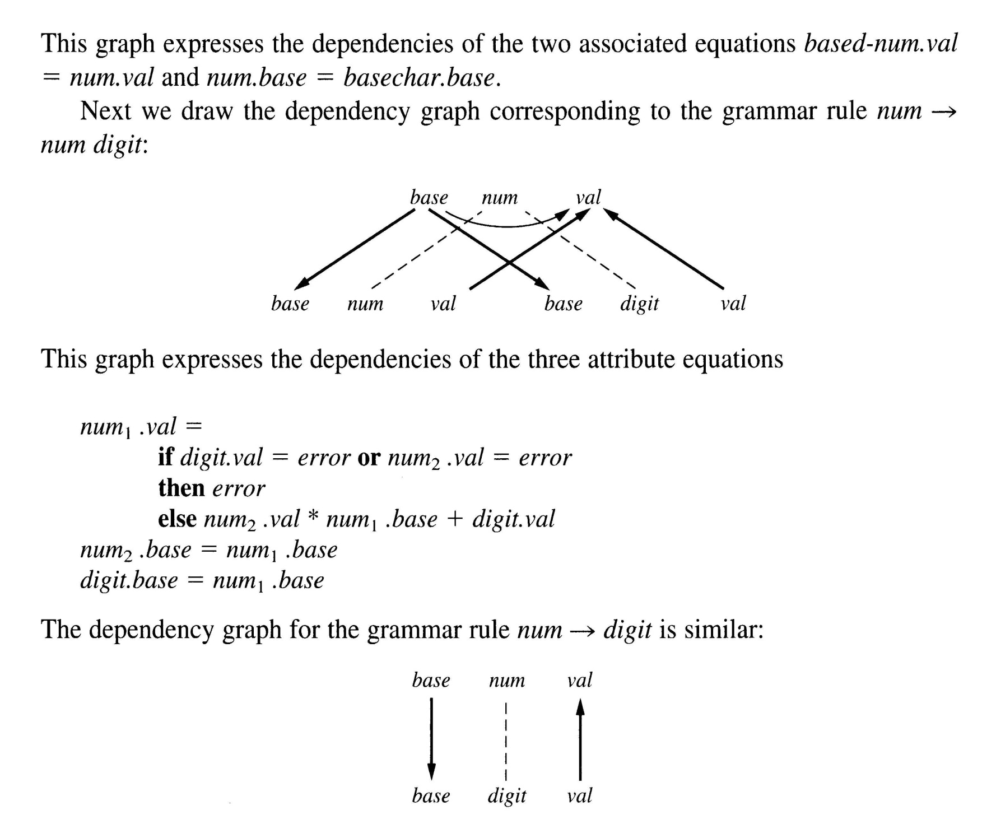

Slide 30
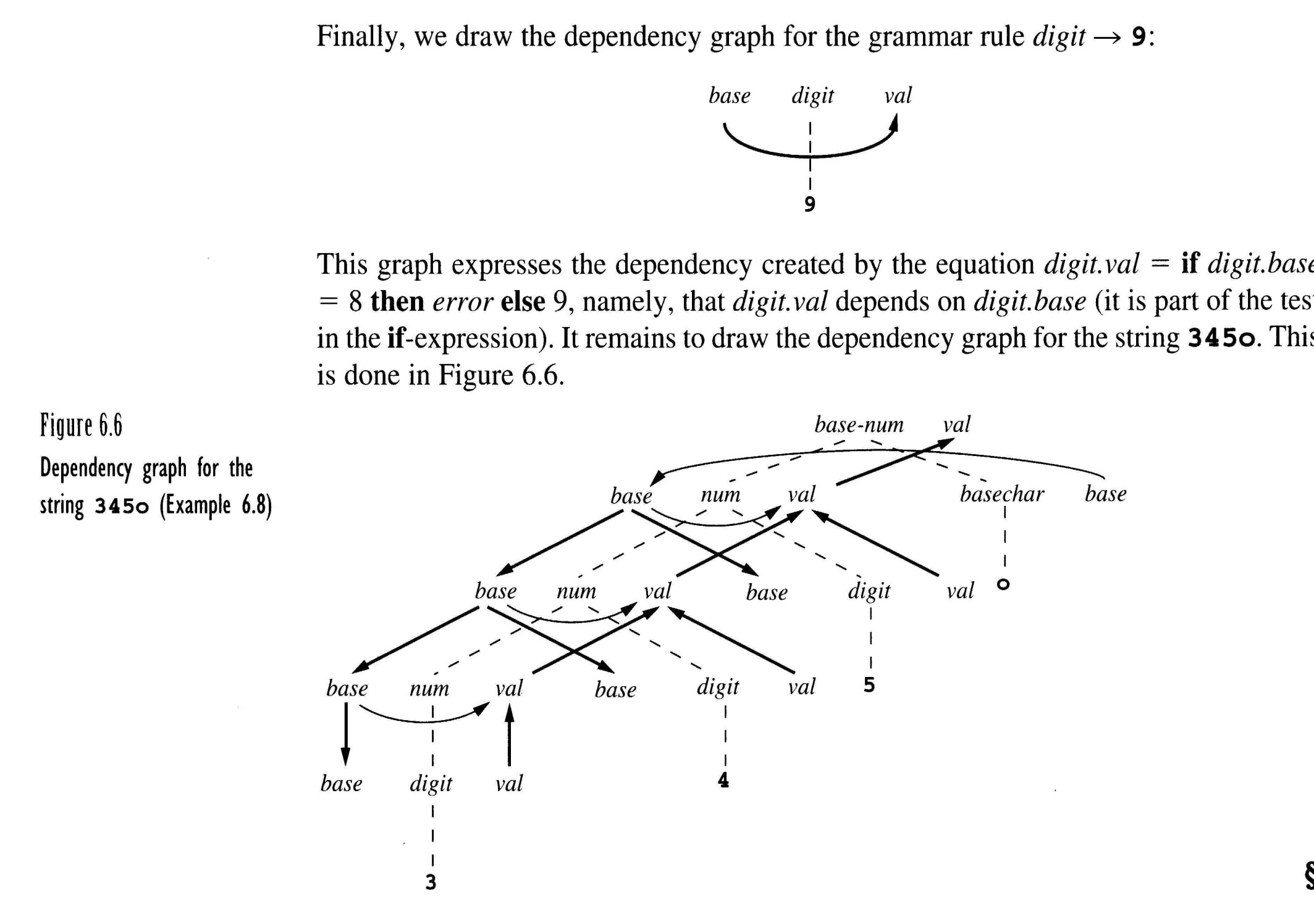

Slide 31
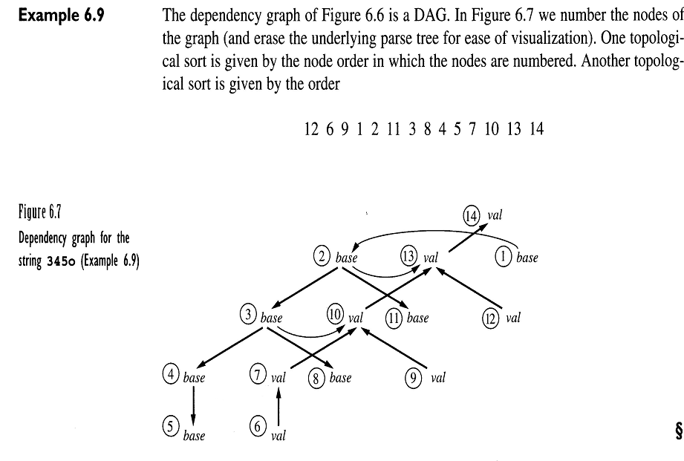

Slide 32
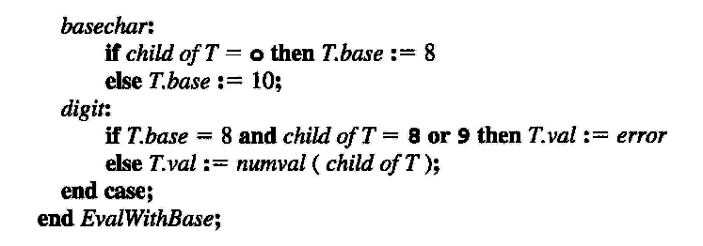
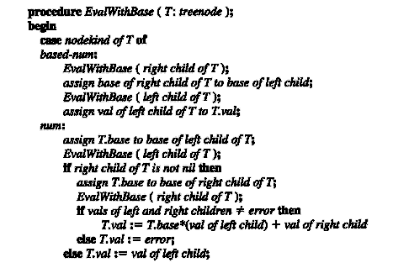
base is computed in
preorder and val in
postorder

Slide 33
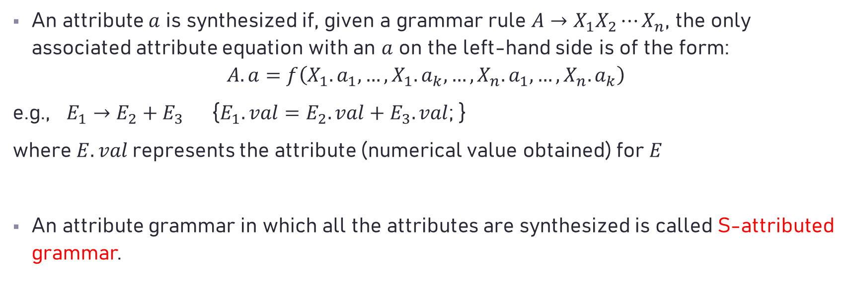
Synthesized Attributes
An attribute $a$ is synthesized if, given a grammar rule $A→X_{1}X_{2}⋯X_{n}$, the only associated attribute equation with an $a$ on the left-hand side is of the form:
$$A.a=f\left(X_{1}.a_{1},…,X_{1}.a_{k},…,X_{n}.a_{1},…,X_{n}.a_{k}\right)$$
e.g., $E_{1}→E_{2}+E_{3}$ {$E_{1}.val=E_{2}.val+E_{3}.val$; }
where $E.val$represents the attribute (numerical value obtained) for $E$
An attribute grammar in which all the attributes are synthesized is called S-attributed grammar.

Slide 35
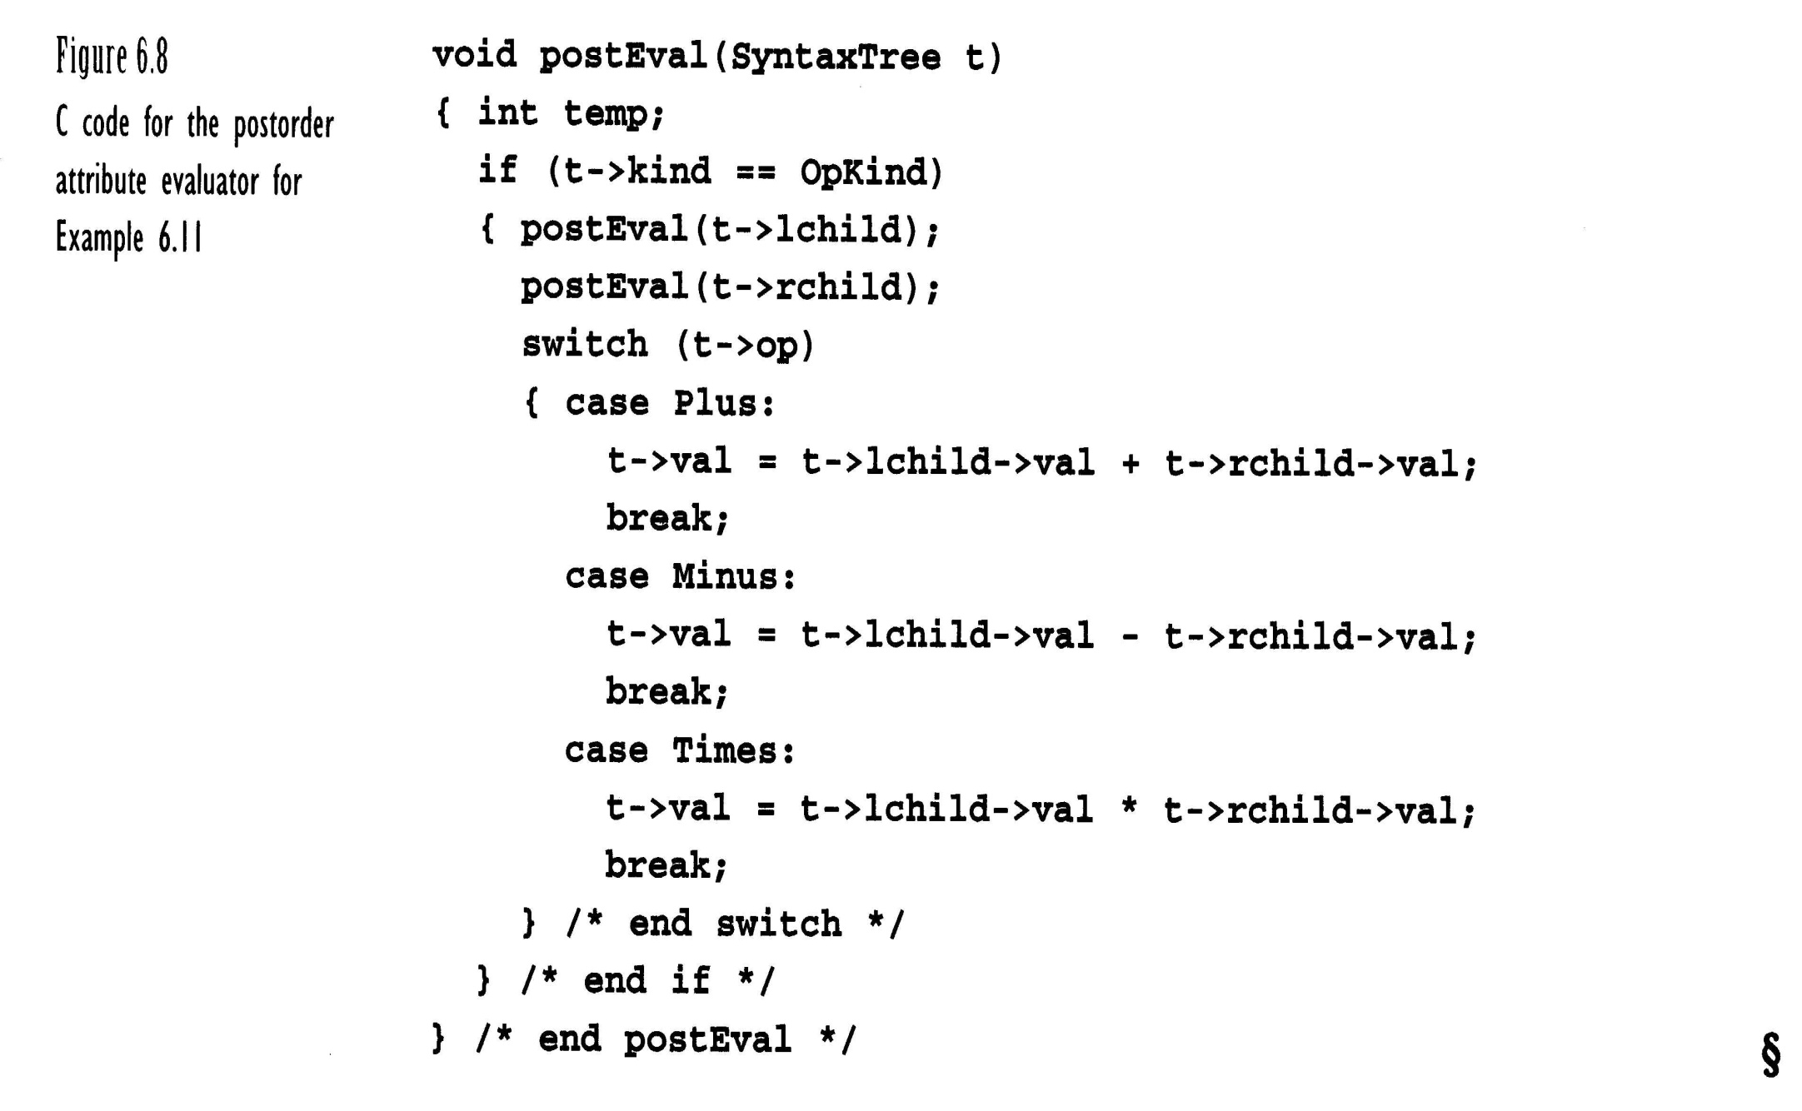
+
-
8
6
4

Slide 36
Inherited Attributes
An attribute that is not synthesized is called an inherited attribute.

Slide 37
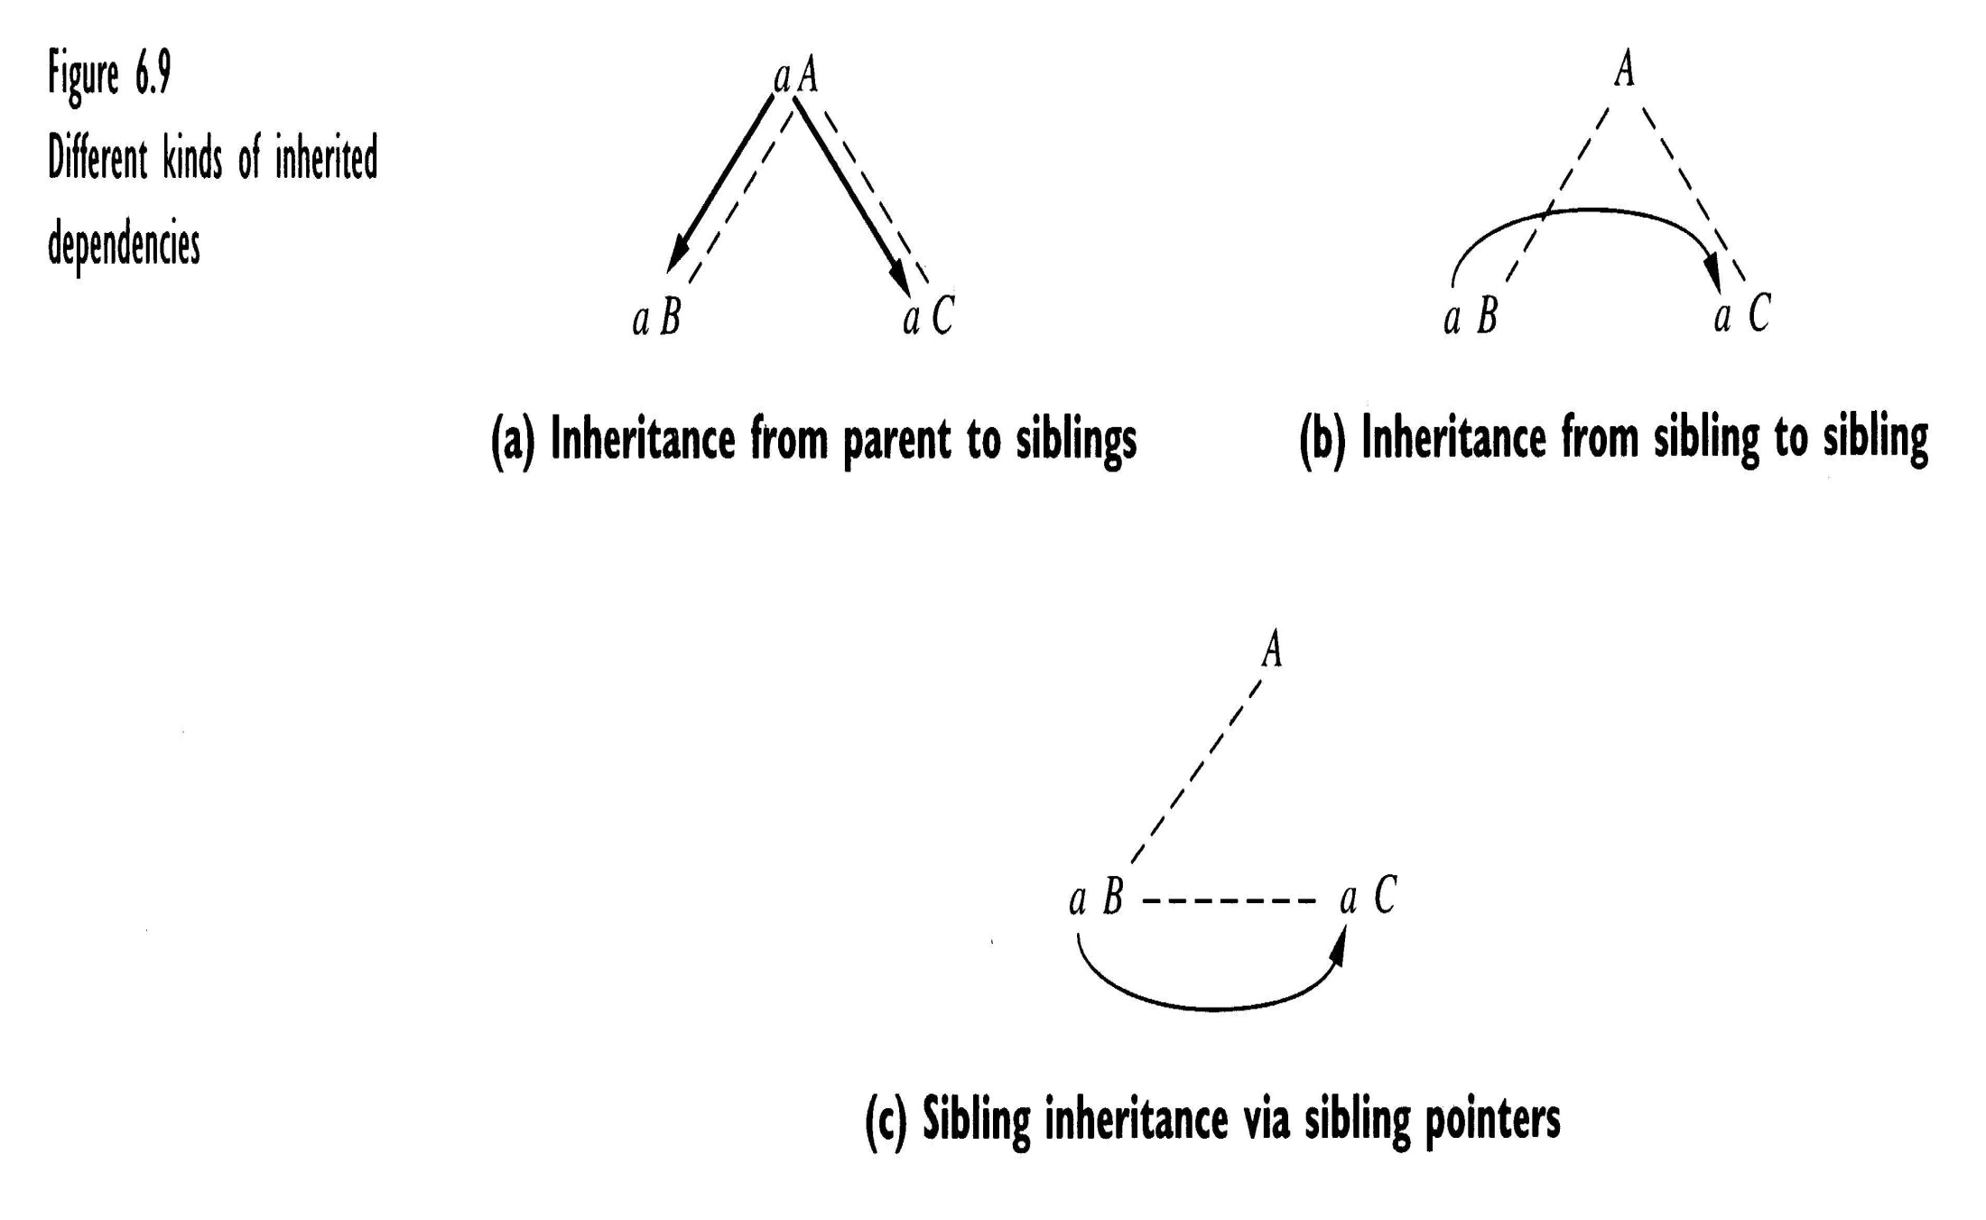

Slide 39
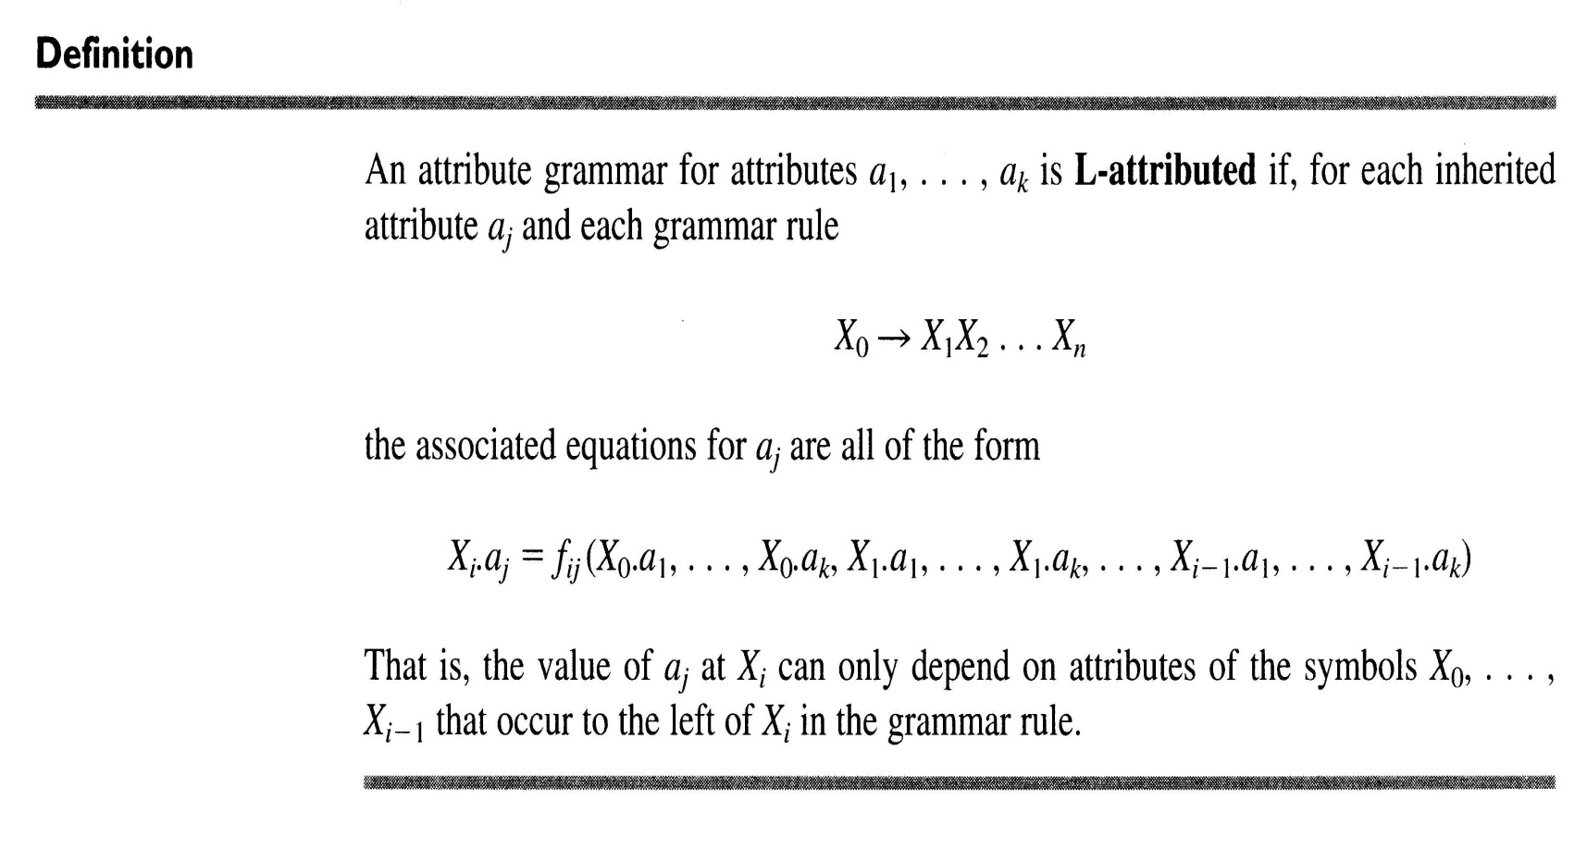
Computation of Attributes During Parsing
L-attributed grammars

Slide 40
Computing Synthesized Attributes During LR Parsing
LALR(1) parser are primarily suited to handling synthesized attributes.
Two stacks are required.
value stack and parsing stack

Slide 41
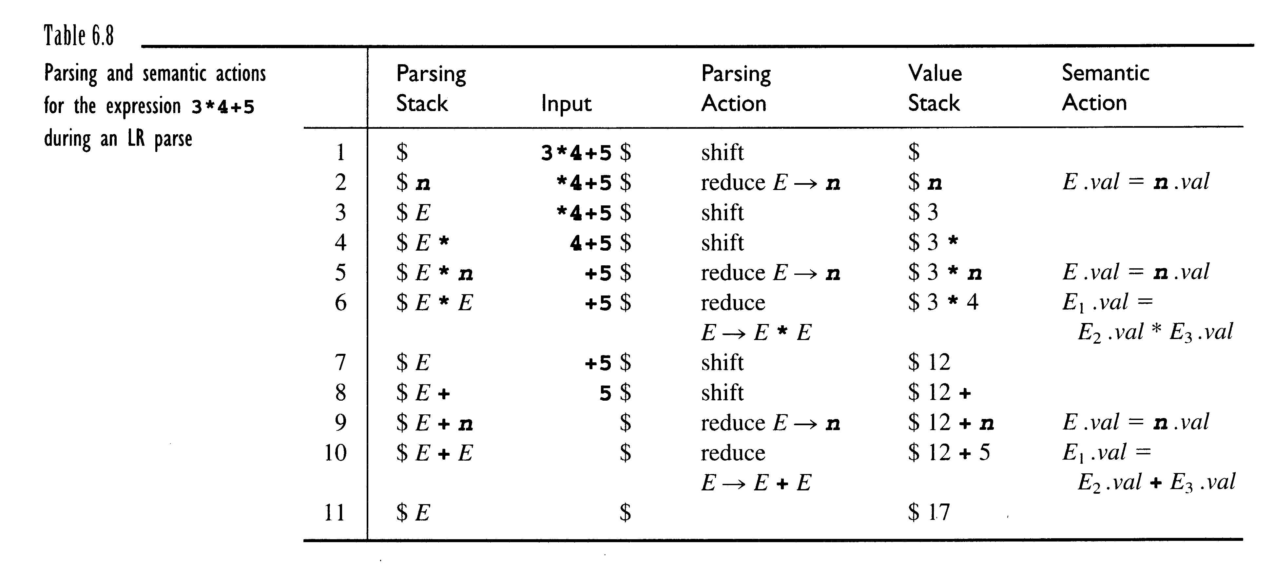

Slide 42
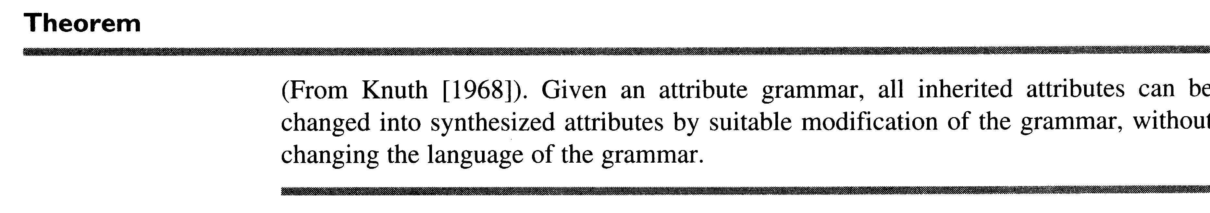

Slide 43
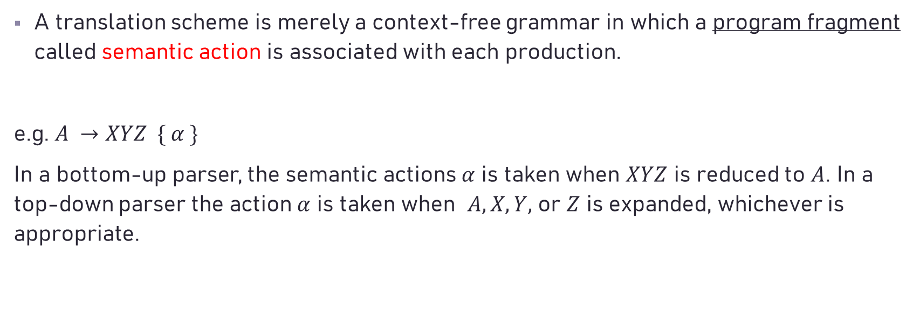
Translation (Attribute Computation)
A translation scheme is merely a context-free grammar in which a program fragment called semantic action is associated with each production.
e.g. $A →XYZ \{ α \}$
In a bottom-up parser, the semantic actions $α$ is taken when $XYZ$ is reduced to $A$. In a top-down parser the action $α$ is taken when $A, X, Y,$ or $Z$ is expanded, whichever is appropriate.

Slide 44
Semantic Action
In addition to those stated before, the semantic action may also involve:
1. the computation of values for variables belonging to the compiler.
2. the generation of intermediate code.
3. the printing of an error diagnostic.
4. the placement of some values in the symbol table.

Slide 45
Consider the following basic programming-language constructs for generating intermediate codes:
Declarations (V)
arithmetic assignment operations (V)
Boolean expressions (V)
flow-of-control statements` if-statement(V) while (V)
array references (Δ)
procedure calls (V)
switch statements (Δ)
structure-type references (Δ)

Slide 46
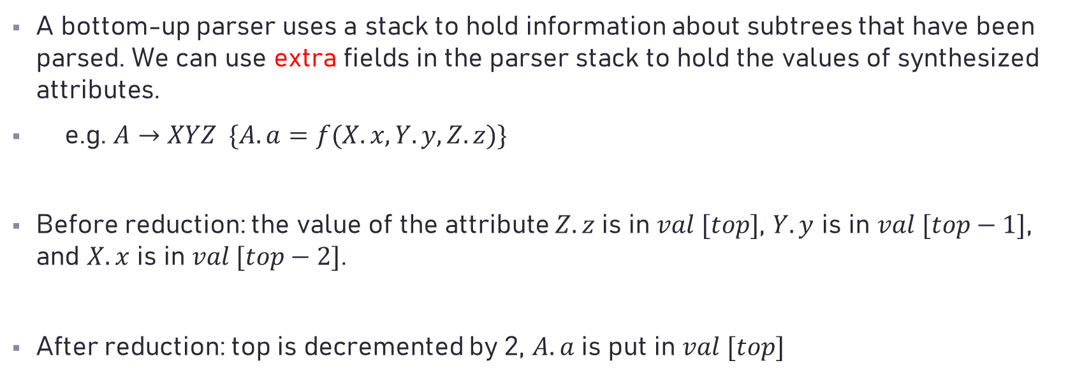
Bottom-up Translation of S-attributed Grammars
A bottom-up parser uses a stack to hold information about subtrees that have been parsed. We can use extra fields in the parser stack to hold the values of synthesized attributes.
e.g. $A→XYZ \{A.a=f(X.x, Y.y, Z.z)\}$
Before reduction: the value of the attribute $Z.z$ is in $val [top]$, $Y.y$ is in $val [top−1]$, and $X.x$ is in $val [top−2]$.
After reduction: top is decremented by 2, $A.a$ is put in $val [top]$

Slide 47
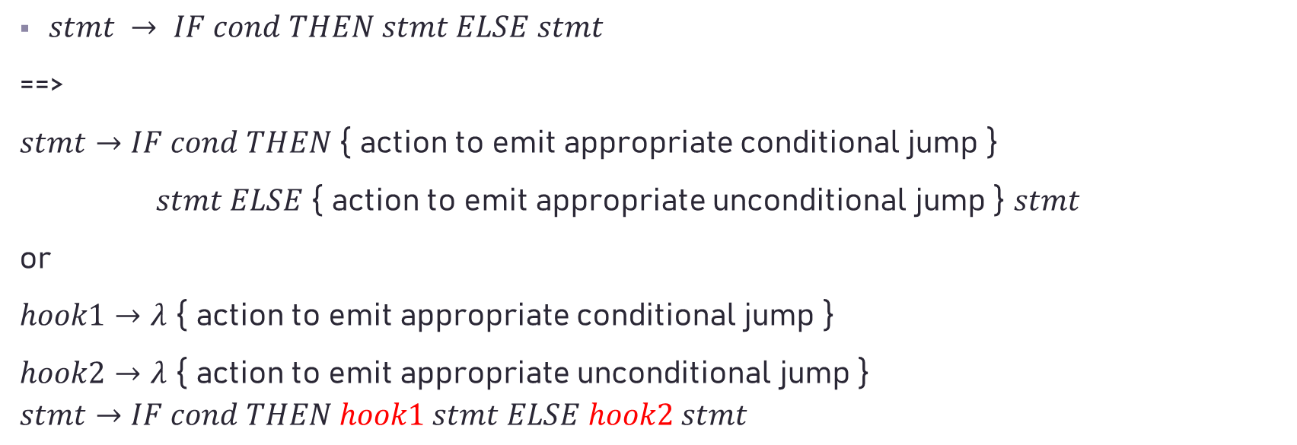
For Special Conditions : Hook
$stmt → IF cond THEN stmt ELSE stmt$
==>
$stmt→IF cond THEN${ action to emit appropriate conditional jump }
$stmt ELSE$ { action to emit appropriate unconditional jump } $stmt$
or
$hook1→λ$ { action to emit appropriate conditional jump }
$hook2→λ$ { action to emit appropriate unconditional jump }
$$stmt→IF cond THEN hook1 stmt ELSE hook2 stmt$$

Slide 48
Semantic Actions for different language constructs
Declarations
e.g. int x, y, z;
float w, z, s;

Slide 49


Suggested grammar: (Note: This is a very simple grammar mainly used for explanation.)
$P → MD;$
$M →λ$/* empty string */
$D → D, id$
$| int id$
$| float id$
P
M
D
;
$$λ$$
D
,
id
int
id
int x , y ;

Slide 50
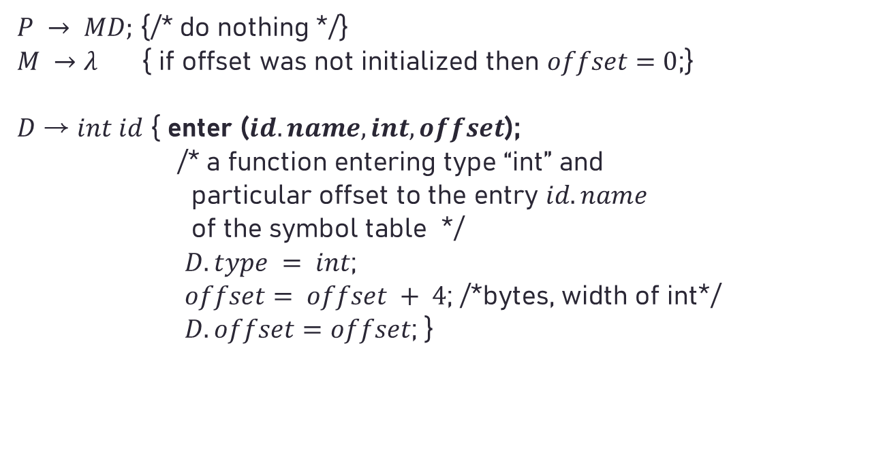
(Syntax-directed) Translation
$P → MD;$ {/* do nothing */}
$M →λ$ { if offset was not initialized then $offset=0$;}
𝐷 → $int id$ { enter ($id.name, int, offset$);
/* a function entering type “int” and
particular offset to the entry $id.name$
of the symbol table */
$D.type = int$;
$offset= offset + 4$; /*bytes, width of int*/
$D.offset=offset$; }

Slide 51
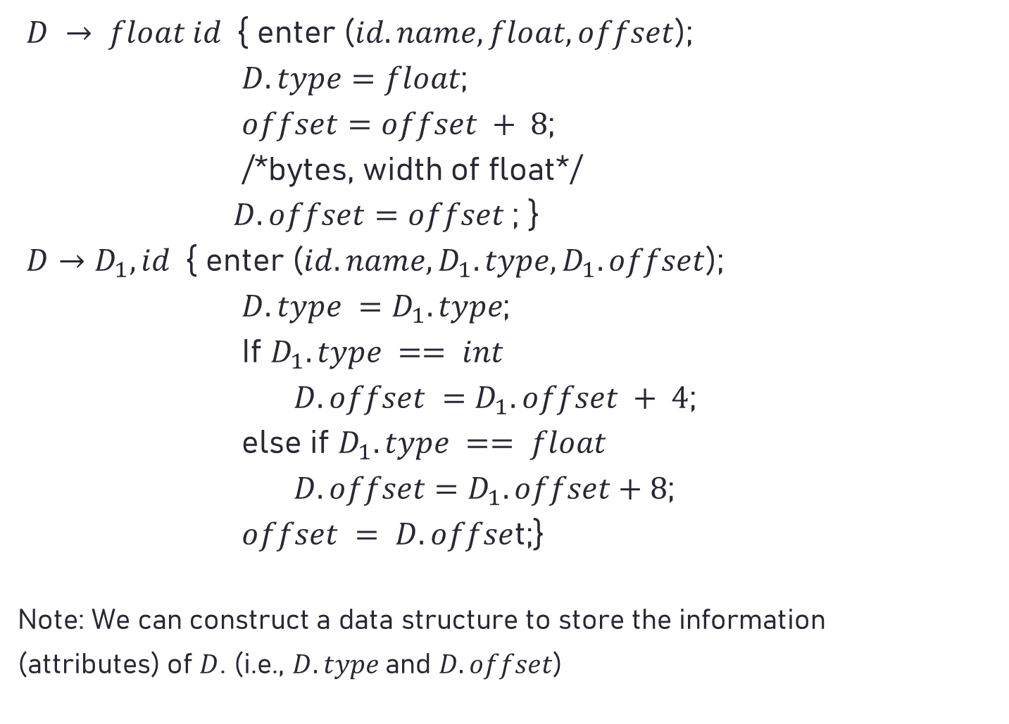
$D → float id${ enter ($id.name, float, offset$);
$D.type=float$;
$offset=offset + 8$;
/*bytes, width of float*/
$D.offset=offset$; }
$D→D_{1}, id${ enter ($id.name,D_{1}.type,D_{1}.offset$);
$D.type =D_{1}.type$;
If $D_{1}.type == int$
$D.offset =D_{1}.offset + 4$;
else if $D_{1}.type == float$
$D.offset=D_{1}.offset+8$;
$offset = D.offse$t;}
Note: We can construct a data structure to store the information
(attributes) of $D$. (i.e., $D.type$and $D.offset$)

Slide 52
Avoided grammar:
D
int
namelist
;
𝐷→𝑖𝑛𝑡 𝑛𝑎𝑚𝑒𝑙𝑖𝑠𝑡 ; | 𝑓𝑙𝑜𝑎𝑡 𝑛𝑎𝑚𝑒𝑙𝑖𝑠𝑡 ;
𝑛𝑎𝑚𝑒𝑙𝑖𝑠𝑡→𝑖𝑑, 𝑛𝑎𝑚𝑒𝑙𝑖𝑠𝑡 | 𝑖𝑑
Why?
When the '𝑖𝑑' is reduced into 𝑛𝑎𝑚𝑒𝑙𝑖𝑠𝑡, we cannot know the type of '𝑖𝑑' (int or float?) immediately. Therefore, it is troublesome to enter such type information into the corresponding field of the '𝑖𝑑' in the symbol table. Hence, we must use special coding technique (e.g. linked list keeping the ids name (pointers to symbol table) to achieve such a purpose. (* In other words, we need backpatch to chain the data type.)
id
int x ;

Slide 53
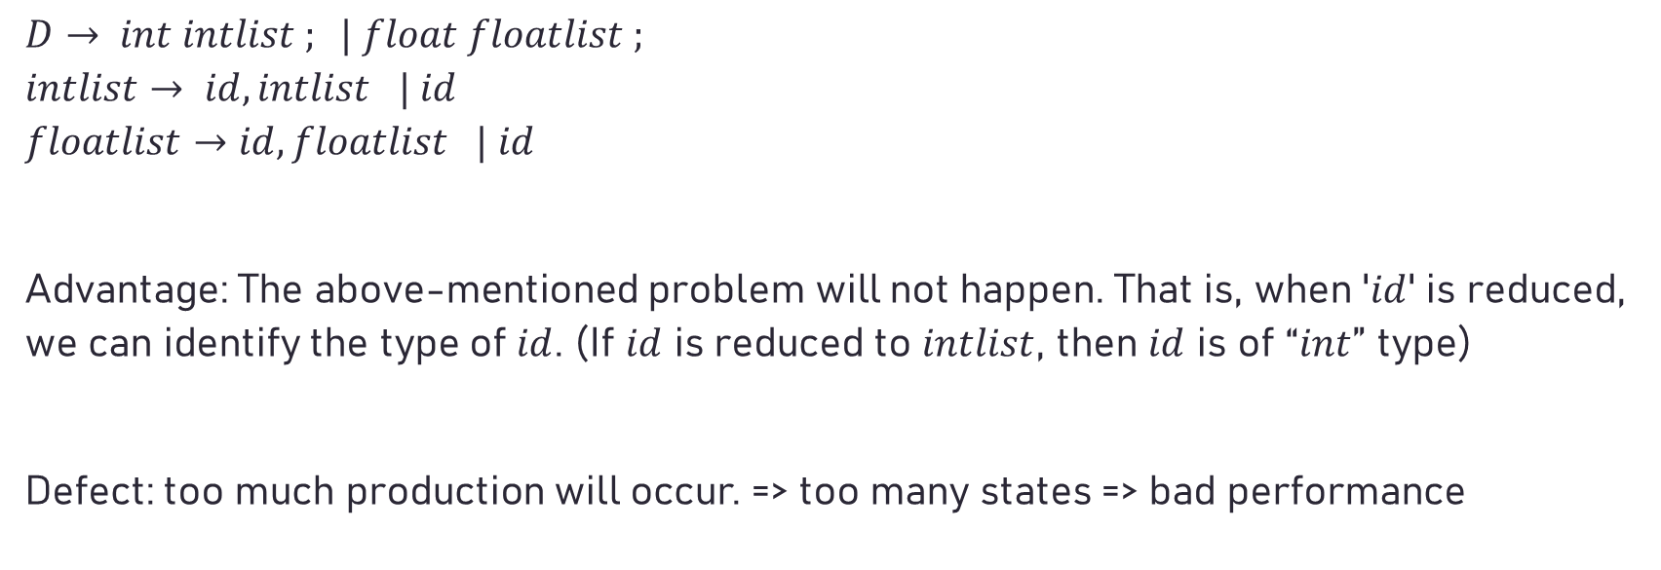
Acceptable grammar
$$D→ int intlist ; | float floatlist ;$$
$$intlist→ id, intlist | id$$
$$floatlist→id, floatlist | id$$
Advantage: The above-mentioned problem will not happen. That is, when '$id$' is reduced, we can identify the type of $id$. (If $id$ is reduced to $intlist$, then $id$ is of “$int$” type)
Defect: too much production will occur. => too many states => bad performance

Slide 54
Grammar with cloned productions

Slide 55

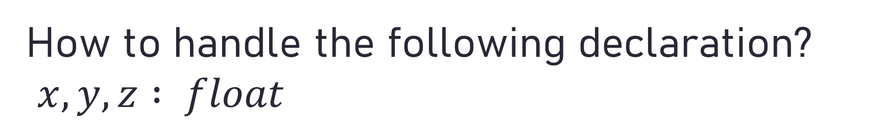
How to handle the following declaration? $x,y,z : float$
Two approaches:
(I) $decl → id_list ′:′ type$
$id_list → id_list ′,′ id | id$
$type → int | float$
(II) $decl→id ′:′ type | id , decl$
$type→int | float$
Which one is better for LR parsing? Why?

Slide 56
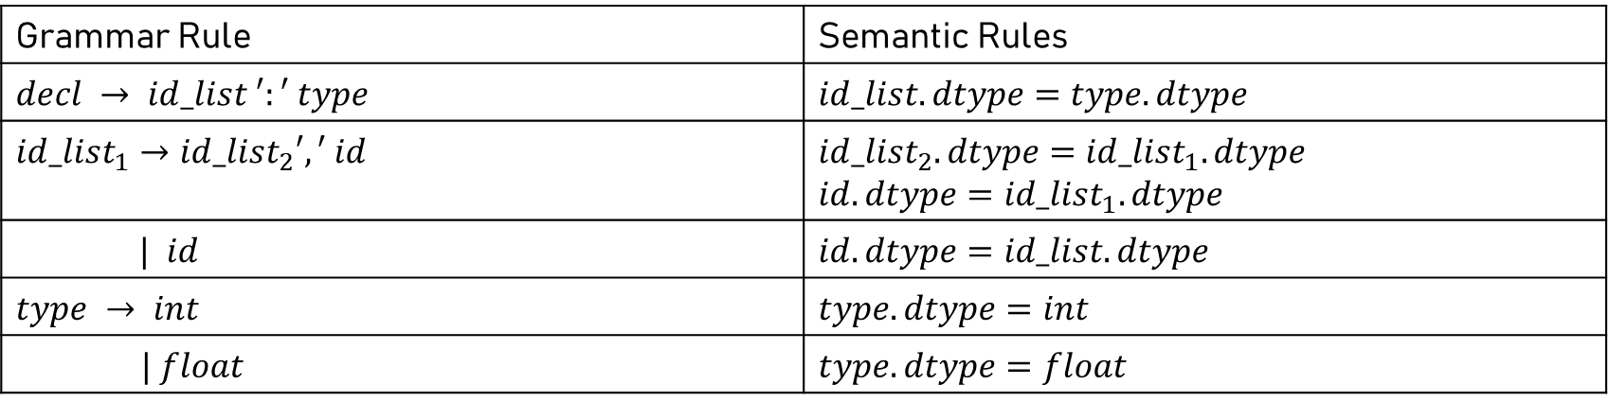
Grammar Rule | Semantic Rules
$$decl → id_list ′:′ type$$ | $$id_list.dtype=type.dtype$$
$${id_list}_{1}→{id_list}_{2}′,′ id$$ | $${id_list}_{2}.dtype={id_list}_{1}.dtype$$ $$id.dtype={id_list}_{1}.dtype$$
$| id$ | $$id.dtype=id_list.dtype$$
$$type → int$$ | $$type.dtype=int$$
$| float$ | $$type.dtype=float$$

Slide 57
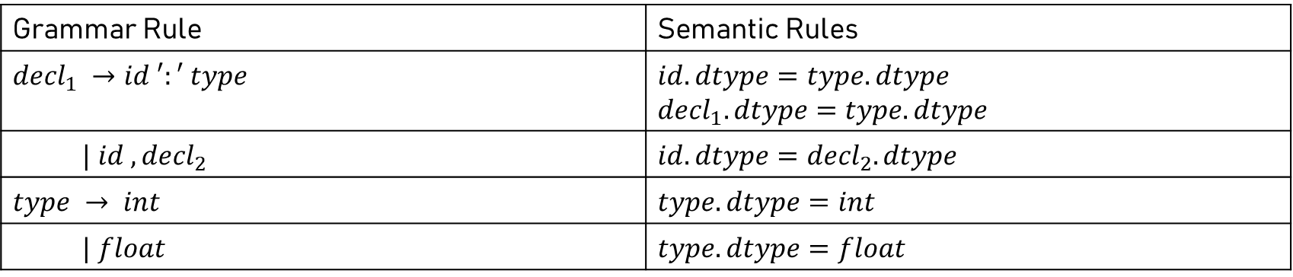
Grammar Rule | Semantic Rules
$${decl}_{1} →id ′:′ type$$ | $$id.dtype=type.dtype$$ $${decl}_{1}.dtype=type.dtype$$
$| id ,{decl}_{2}$ | $$id.dtype={decl}_{2}.dtype$$
$$type → int$$ | $$type.dtype=int$$
$| float$ | $$type.dtype=float$$

Slide 58
Suggested Grammar for the following Declaration: var x,y,z : real; u,v,t : integer; …
declarations : VAR decl_list
| /* empty (no declaration is permitted) */
;
decl_list : declaration ';'
| declaration ';' decl_list
;
declaration : ID ':' type
| ID ',' declaration
;
type : REAL
| INTEGER
;

Slide 59
Try to construct a parse tree for the following declaration and see how to parse it: var x: real; y: integer;
declarations
VAR decl_list
var declaration ; decl_list
ID : type declaration ;
x real ID : type
y integer

Slide 60
The following grammar for declaration is difficult for attribute gathering.
declaration : id_list ':' type ;
id_list : ID
| id_list ',' ID
type : REAL
| INTEGER

Slide 61
e.g., declaration
id_list : type
id_list , ID REAL
id_list , ID
ID

